Slide 1
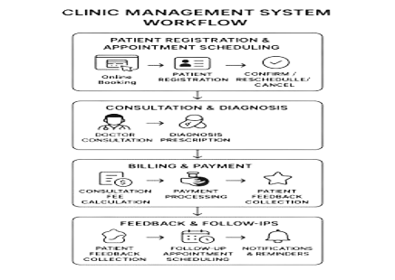
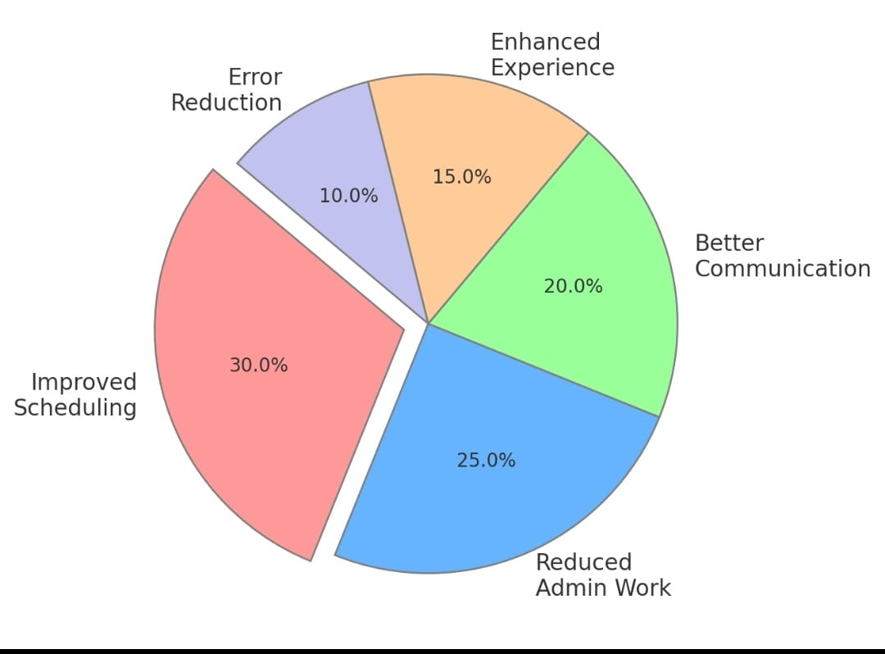
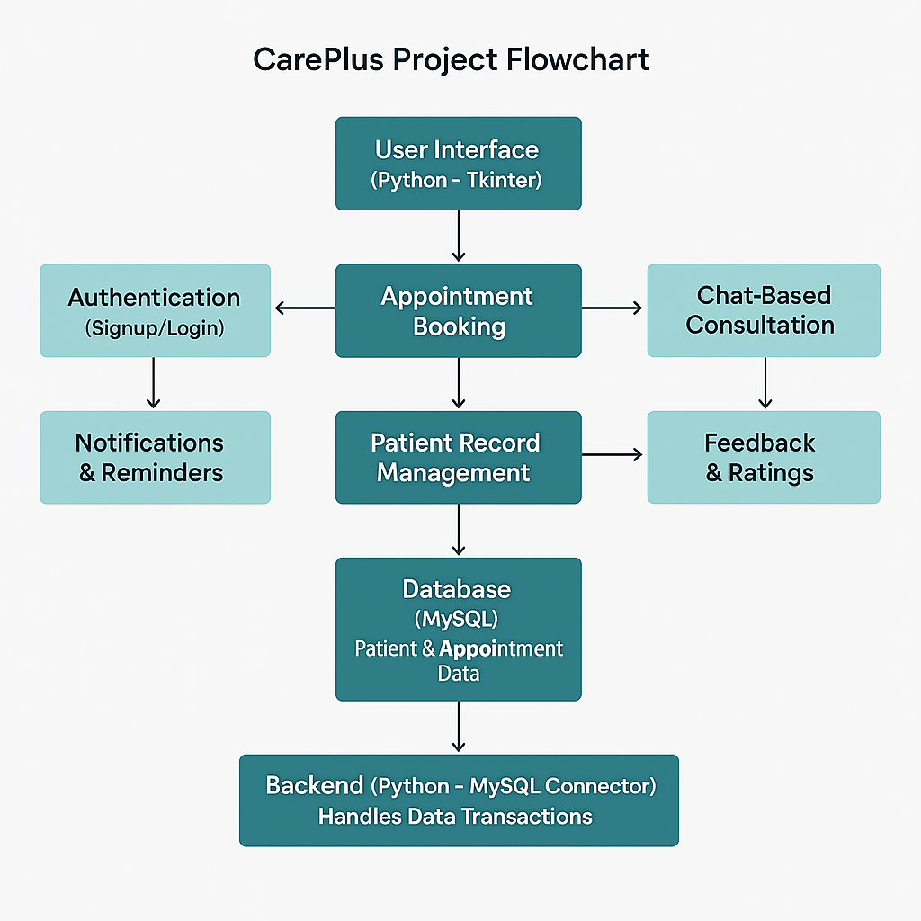
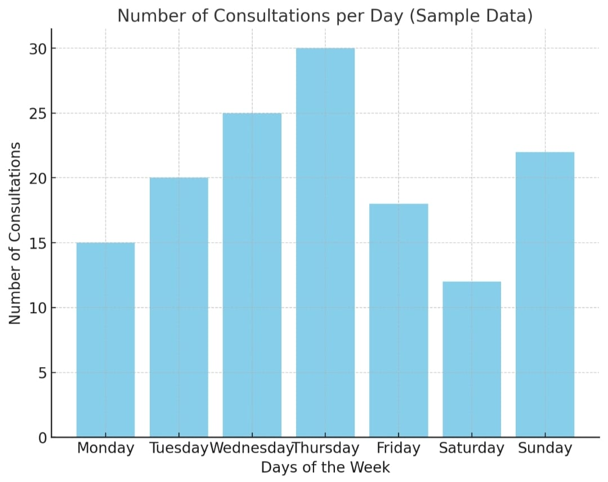
CarePlus : A SmartCare Clinic
Problem statement :
Manual Record-Keeping & Data Loss : Clinics often rely on paper records, which can be misplaced or damaged.
Inefficient Appointment Scheduling : Overlapping appointments and long wait times cause inconvenience.
Lack of Communication Between Patients & Clinic : Patients struggle to reach the clinic for queries or updates.
Objectives :
To automate appointment scheduling, registration and report generation.
To provide feedback system for doctors and patients.
To build remainder and notification system.
To provide patients with quick answers through chat support.
Workflow :
Results:-
BlockDiagram :
Key References:
https://www.practo.com/providers/clinics/ray
https://itxperts.co.in/blog/hospital-management-system-using-python/
https://realpython.com/python-gui-tkinter/
Conclusion :
CarePlus allows patients to book appointments online from anywhere and can consult through messages. It reduces manual work and improves efficiency. This system ensures better patient care and smooth clinic operations.

